Slide 1
3 minutes
for positivity

Slide 2
Task: How many
“Questions words” do
you know? Write them.
Who What When Where Why How
Is Are Do Did Have Had

Slide 3
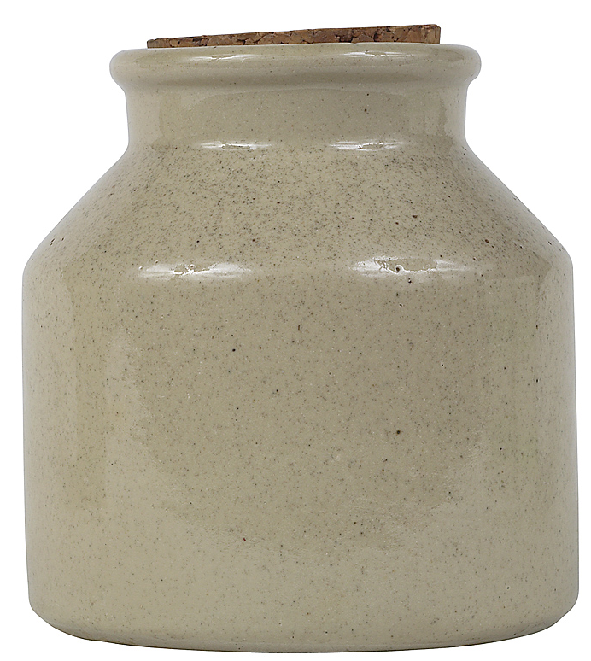
savo
“to attend to,
appreciate,
and enhance
positive experiences”
- Bryant & Veroff
savoring
Notes:
Fred Bryant

Slide 4

Remember
good things
Notes:
Count your blessings

Slide 5
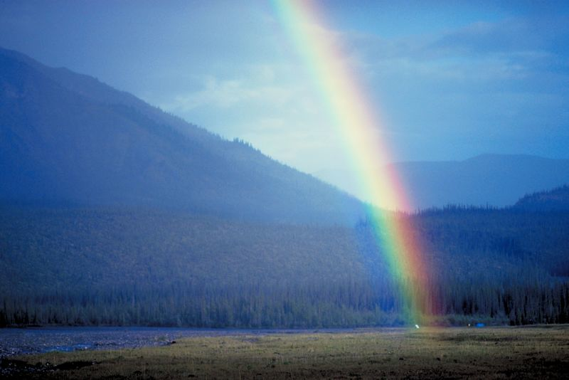
Notice good things
Notes:
This is different than remember. This is real time. English teacher: Remembering is past tense. This is present, present simple, present continuous. RIGHT Now

Slide 6

Anticipation

Slide 7
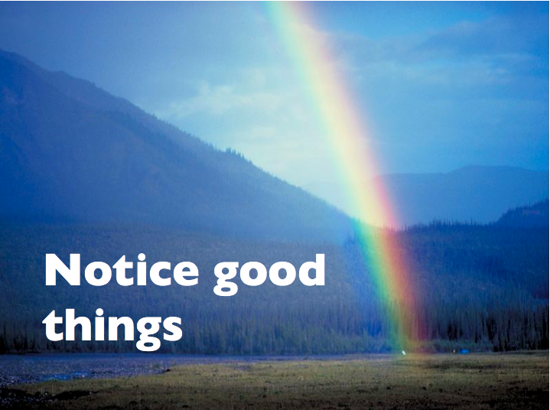


savoring

Slide 8
3-minute pairwork
Topic:
What is an experience
you really enjoyed?

Slide 9
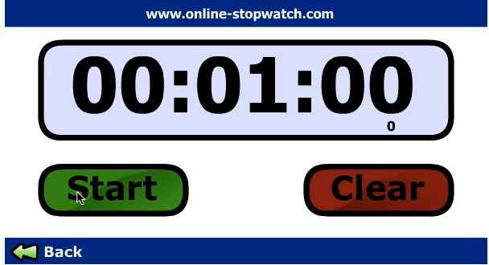
What is an experience
you really enjoyed?
1 minute
Think Time
What do I want to say?
How will I say it?

Slide 10
What is an experience
you really enjoyed?
Pairwork
A speaks. 1 minute.
B ask questions.
Check (√) question words.

Slide 12
The “question words” kept
the conversation going.
How do you feel now?
You “re-experienced”
that happy time.

Slide 13




’
Language learning:
discourse strategy
Notes:
“Active – Constructive” responses – They help the partner mentally recreate the emotion
-- good psychologically
-- good conversation strategy

Slide 14
’
Positive psychology:
Active Constructive Response
Notes:
“Active – Constructive” responses – They help the partner mentally recreate the emotion
-- good psychologically
-- good conversation strategy

Slide 15
’
Your partner got a job promotion.
Active
Constructive
Wow. Great.
Tell me all
about it.
Passive
Constructive
Wow. Great.
That’s nice.
Active Destructive
Oh. Now you are
going to be even
busier than now.
Passive Destructive
That’s nice.
What’s for dinner?
Notes:
“Active – Constructive” responses – They help the partner mentally recreate the emotion
-- good psychologically
-- good conversation strategy
Promotion - Active constructive – Wow. Tell me all about it.
Passive constructive – That’s nice.
Passive destructive – That’s nice. What’s for dinner.
Active destructive – Oh great. Now you’re going to be even busier.

Slide 16
https://www.eltandhappiness.com/new-3-minutes-for-positivity.html

