Slide 1
bef
S
Happiness 2.0
Marc Helgesen
MICELT
October 2012
Notes:
Excited, delighted.
Who are you?
Positive psychology

Slide 2
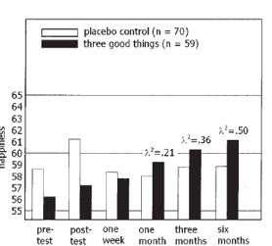
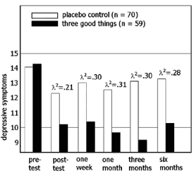
Depressive
symptoms

Slide 3
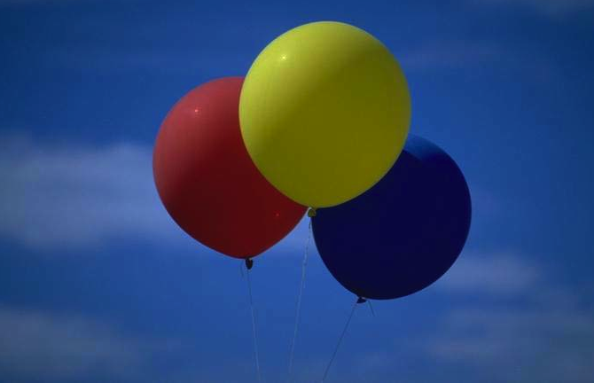
7 days
☺
6
months
of results
3 good things, today!
Notes:
Happier,
Less depression
People tend to keep doing the noticing

Slide 4
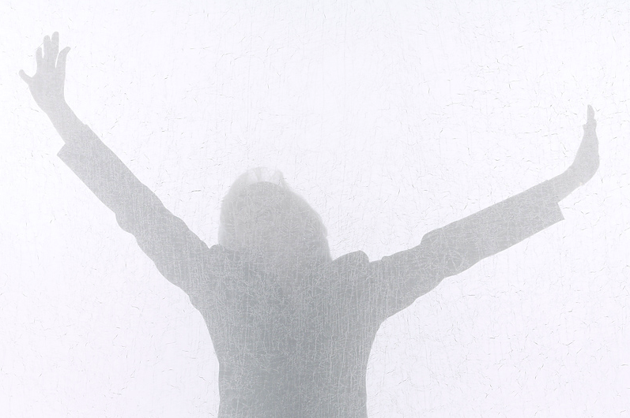
Positive
Emotion
Notes:
Happiness activities –
Easy to do in the classroom
Easy to connect

Slide 5
.com
Notes:
Next, how to introduce those
8 ideas into the elt classroom
You don’t have to remember. Download

Slide 6
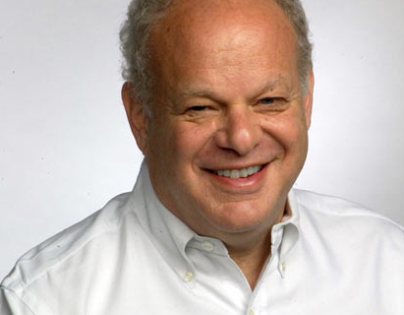
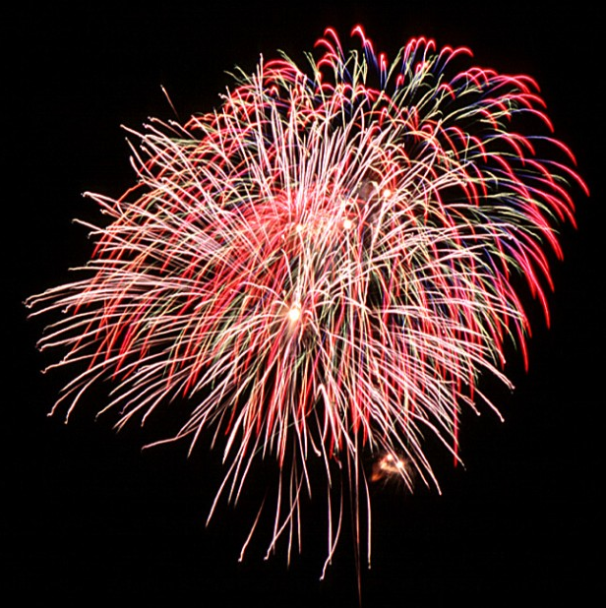
Flourish
P
E
R
M
A
ngagement
Notes:
Wellbeing 2.0

Slide 7
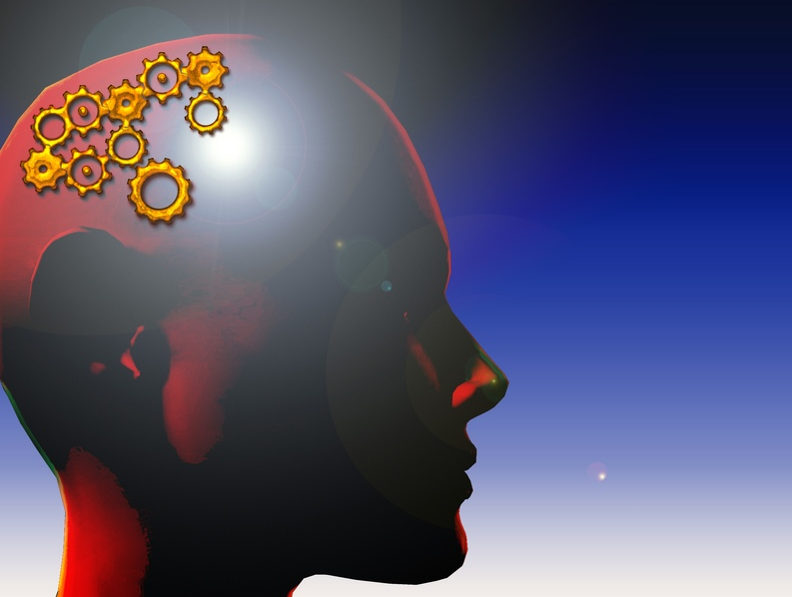
Engagement
Notes:
Engagement – getting student, not just studying English, but really involved. Really USING English.

Slide 8
Memory check
P
E
R
M
A
ositive Emotion
ngagement
elationships
eaning
ccomplishment
Notes:
Wellbeing 2.0

Slide 9
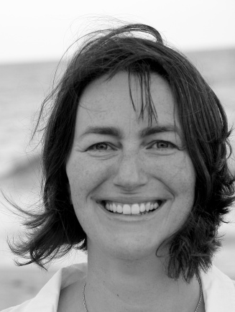
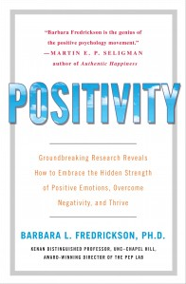
PEP Lab
Notes:
Dr. Barbara Fredrickson,
Runs the Univ North Carolina Chapel Hill- Runs the”Positive Emotions and Psychotherapy Lab”.
Makes is clear – science, not pop-psych, touchy-feely
Has been studying positive emotions --

Slide 10
3 : 1
Positivity Negativity
The tipping point
Notes:
A math equation! Called the Losada ratio (after Brazilian Marcel Losada who turned Fredricksen’s Broaden and Build theory into a mathematical model
Tipping point: point of transition
Critical mass

Slide 11
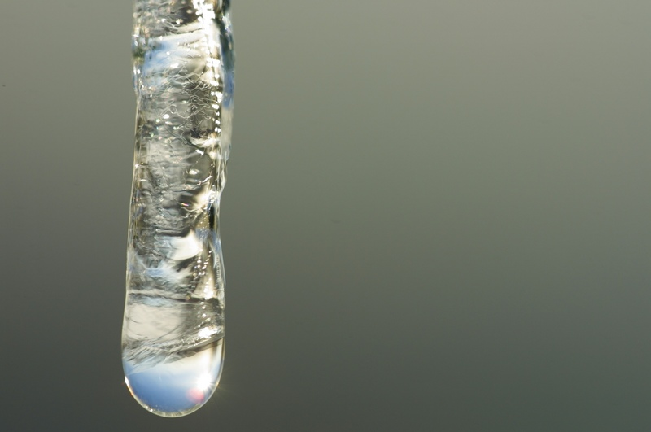
The
tipping
point
0^{o C}
Notes:
Tipping point: point of tranformation
Metaphor? (Gladwell) No
Easiest example: Water. Ice: 0 degrees celcius: melts

Slide 12
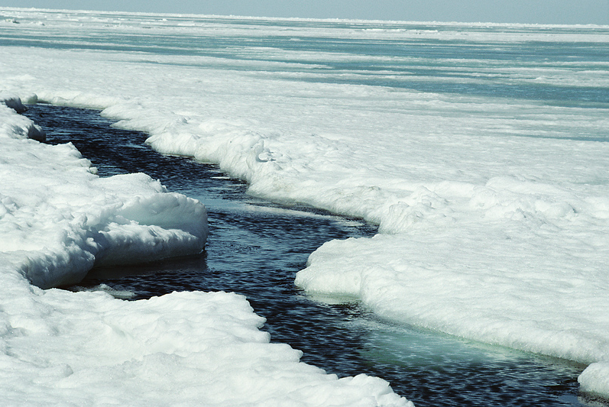
The
tipping
point

Slide 13
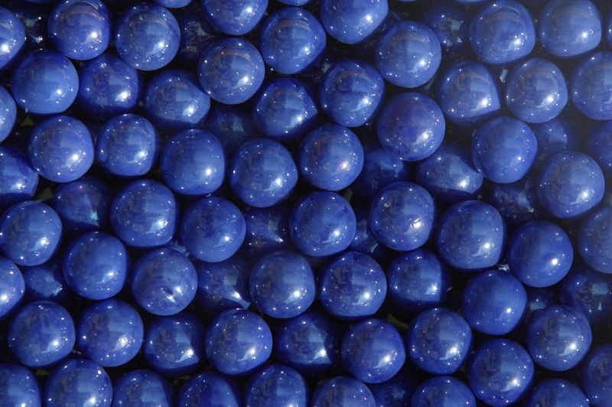
The tipping point
Notes:
Point at which things move from being rare, unusual, to occurring frequently,
Point of critical mass
When we get our lives to a point of 3 positive experience for each negative, great positive emotion, creativity, etc.
(Fredrickson avoies the word “happiness” – can’t quantify it.

Slide 14
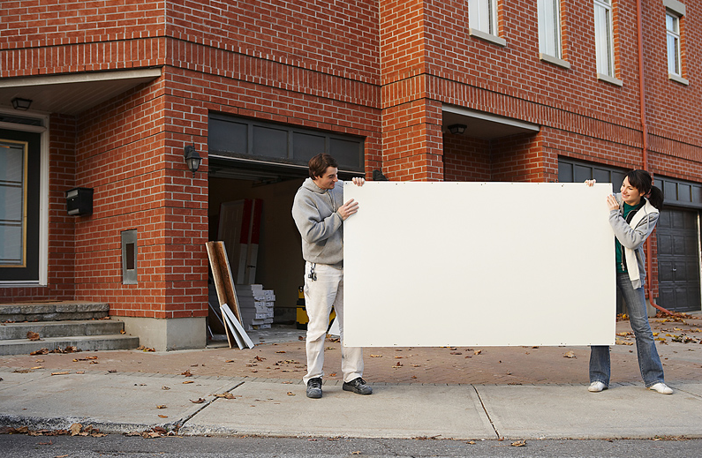
10 kinds of
positive
emotion

Slide 15
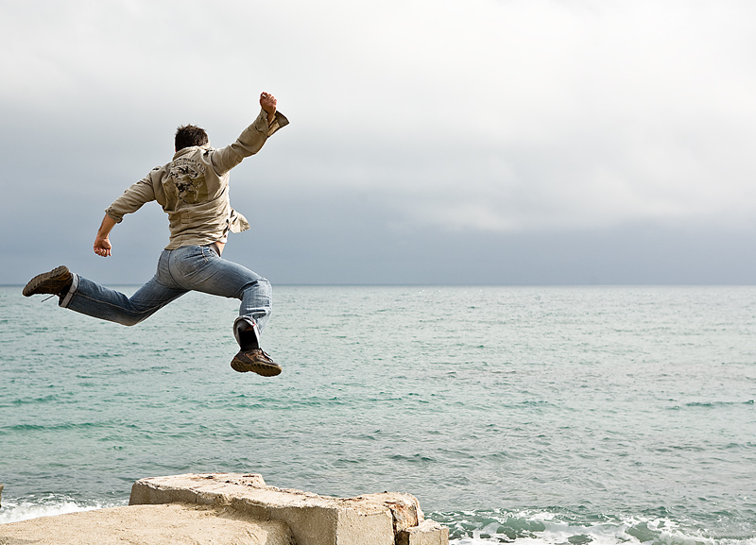
Joy

Slide 16
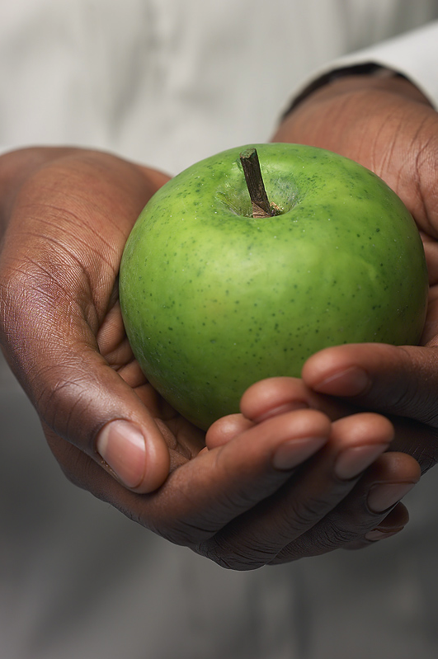
Gratitude
saying thanks

Slide 17
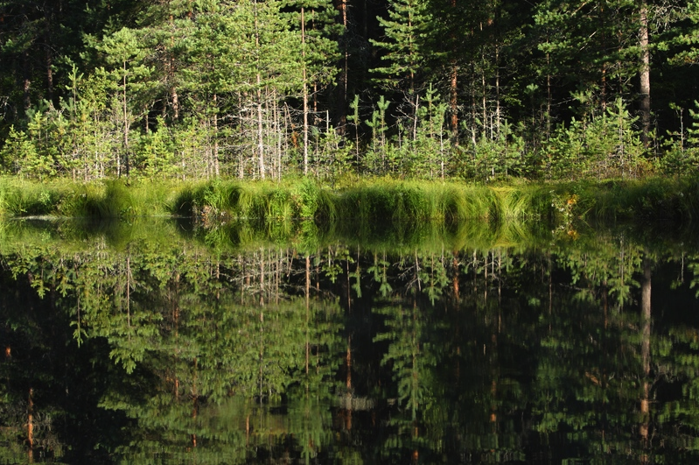
Joy
Serenity
a peaceful mind

Slide 18
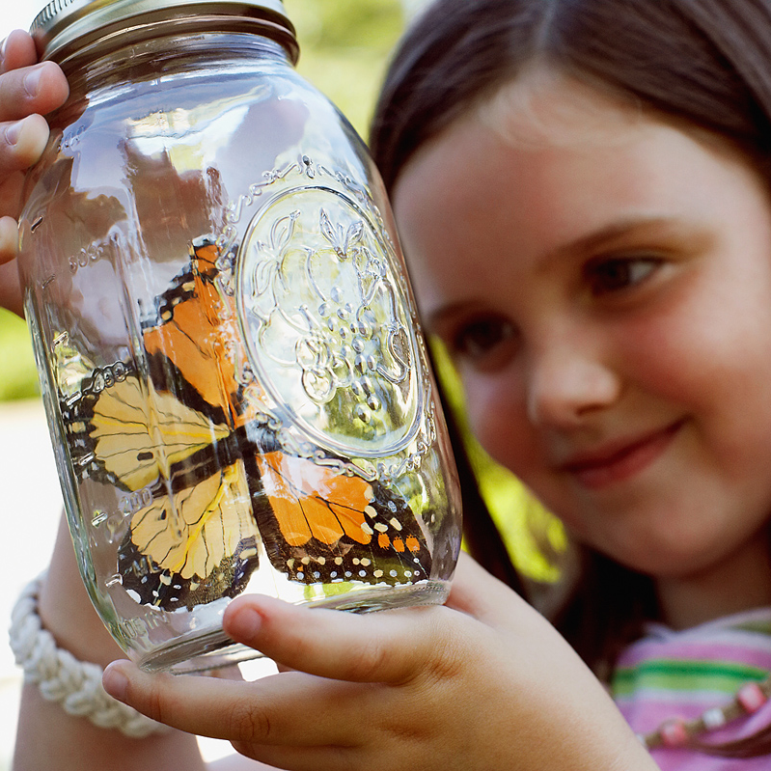
Interest
Joy
Notes:
Related to flow
So interested that suddenly 5 hours went by

Slide 19
Joy
Hope

Slide 20
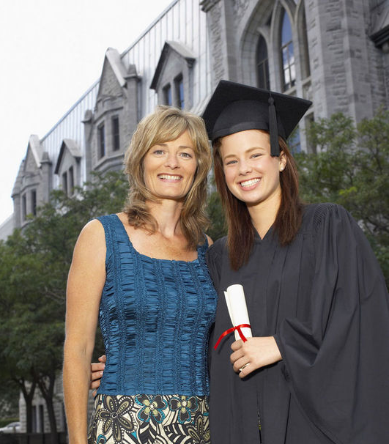
Joy
Pride
Notes:
Jpz Ss – negative
Not if done right

Slide 21
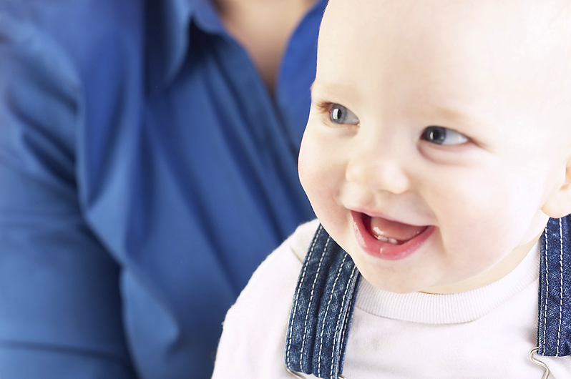
Amusement
Joy

Slide 22
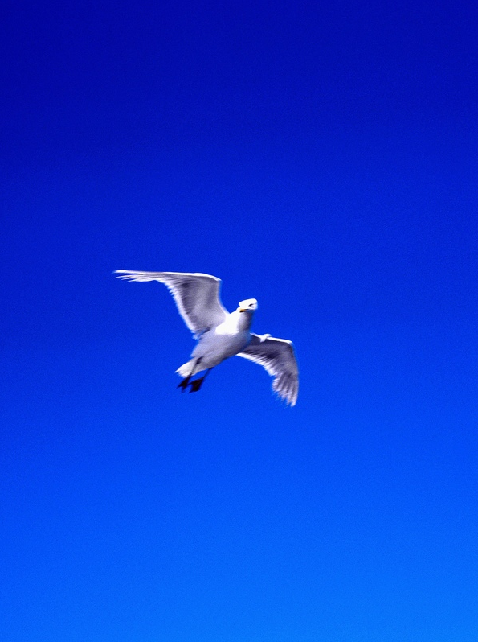
Inspiration

Slide 23
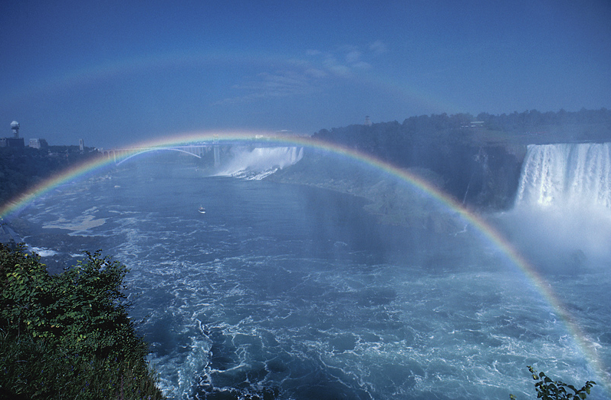
Awe
So wonderful there are no words
Joy

Slide 24
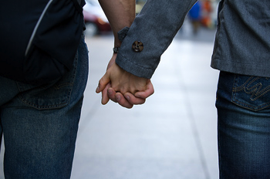
Joy
Love
Notes:
Romantic. Family. Caring about friends.

Slide 25
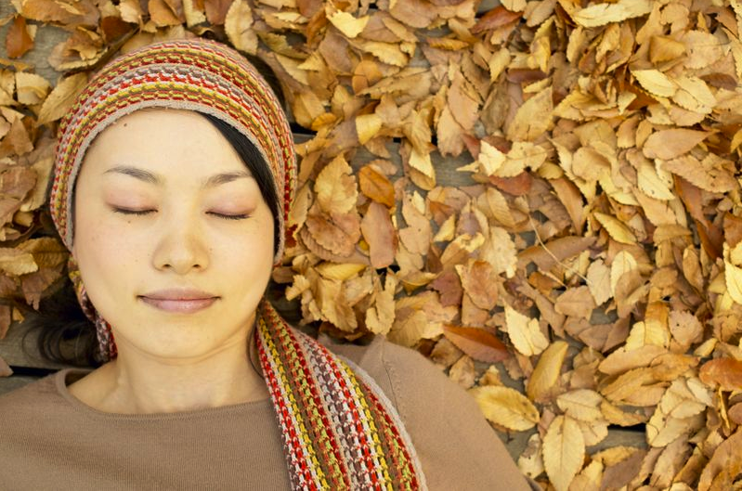

Slide 26
’

Slide 28
Notes:
Notice: Just thinking of those topics – you mentally reexperience the event

Slide 29
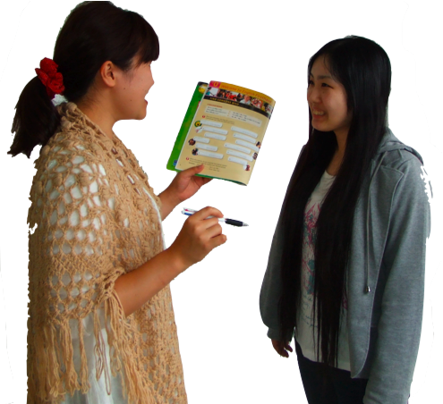
Engaging, personalized, multi-sensory activities
Storm & Tecott 2005) in Willis in Sousa, 2010
Notes:
Engaging activities. Engagement can lead to flow. Involvement, investment.
Storm & Tecott 2005) in Willis in Sousa, 2010

Slide 30
Engaging activities
Focus,
memory,
motivation
Storm & Tecott 2005) in Willis in Sousa, 2010
Notes:
Dopamine ---
Engaging activities. Engagement can lead to flow. Involvement, investment.
Storm & Tecott 2005) in Willis in Sousa, 2010

Slide 31
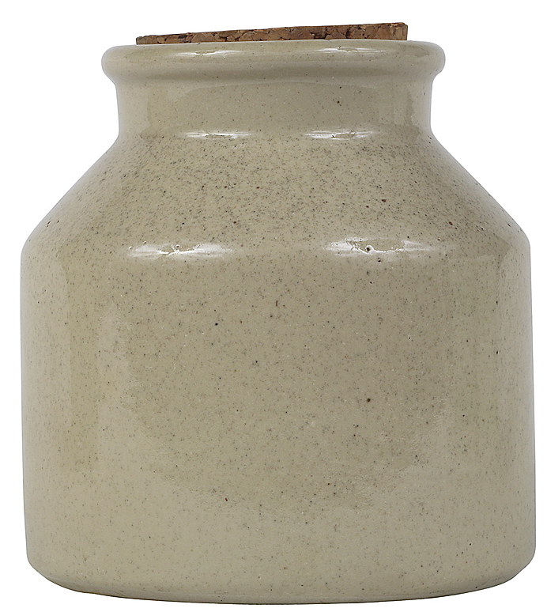
savo
savoring
“to attend to,
appreciate,
and enhance
positive experiences”
- Bryant & Veroff
Notes:
Fred Bryant

Slide 32
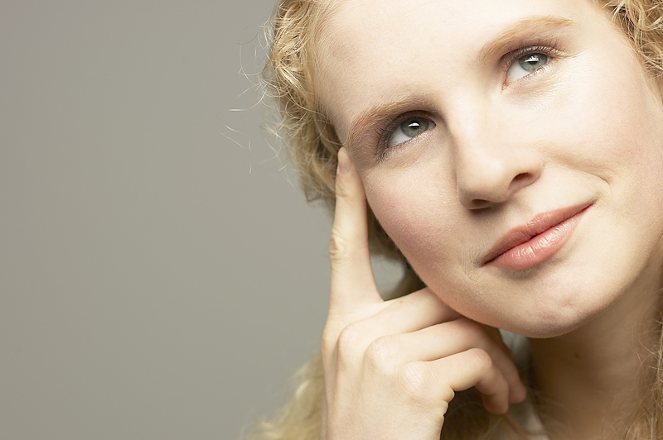
Remember
good things
Notes:
Count your blessings

Slide 33
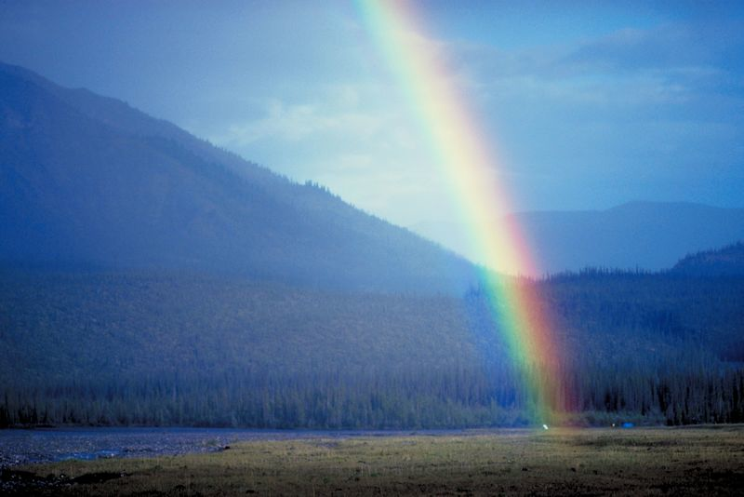
Notice good things
Notes:
In the present –
mindfulness

Slide 34
Anticipation

Slide 35
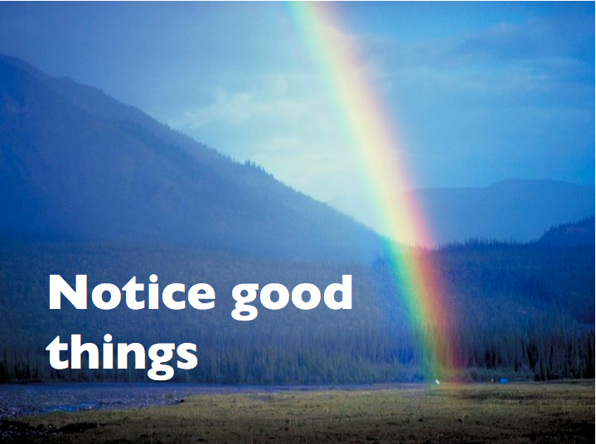
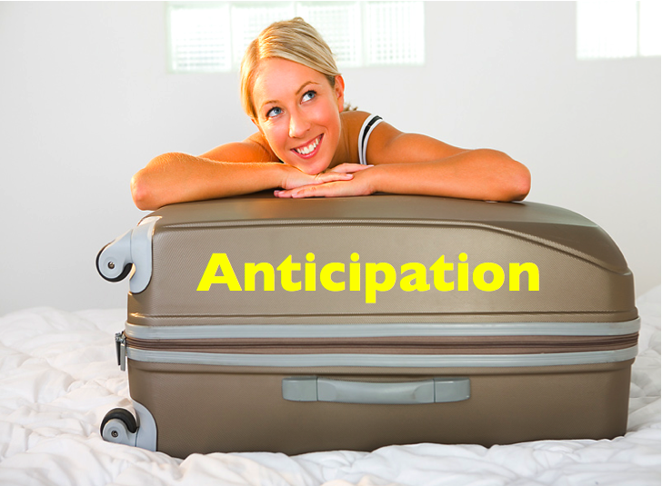

Slide 36
savo
savoring

Slide 37
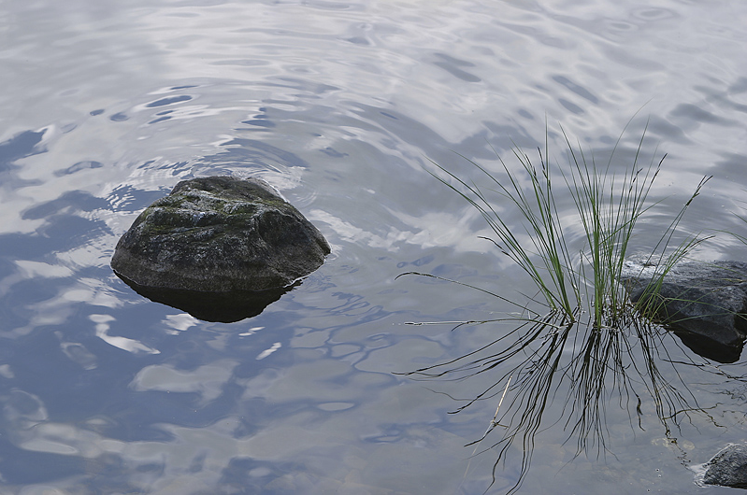
1
simplify

Slide 38
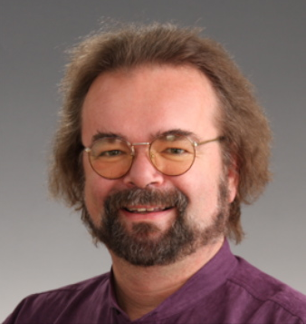

Slide 39
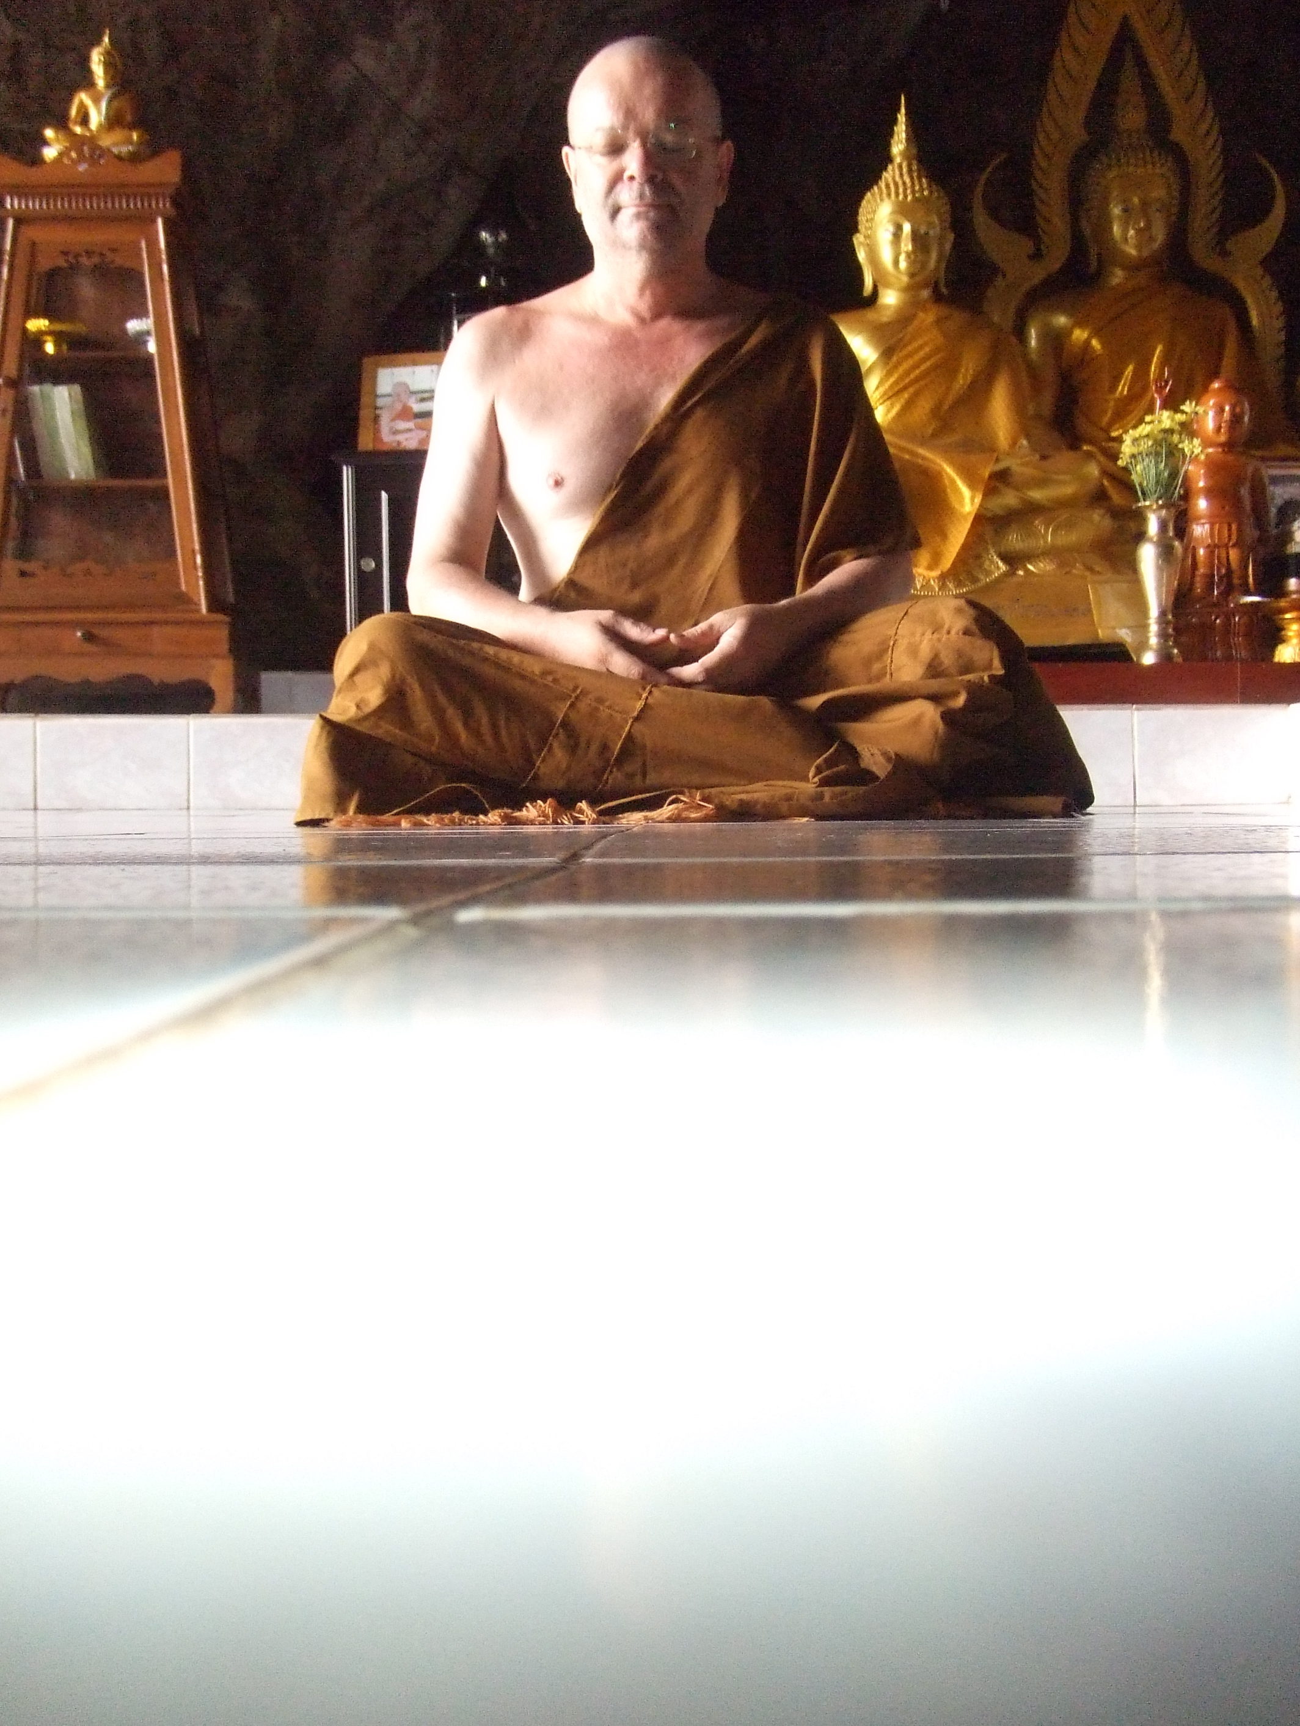
How I spent
my summer
vacation
Notes:
There have been fascinating studies at the U of Wisconsin- Madison. Hooking up Buddhist Monks to fMRI’s – yeah, their brains really are operating differently.

Slide 40
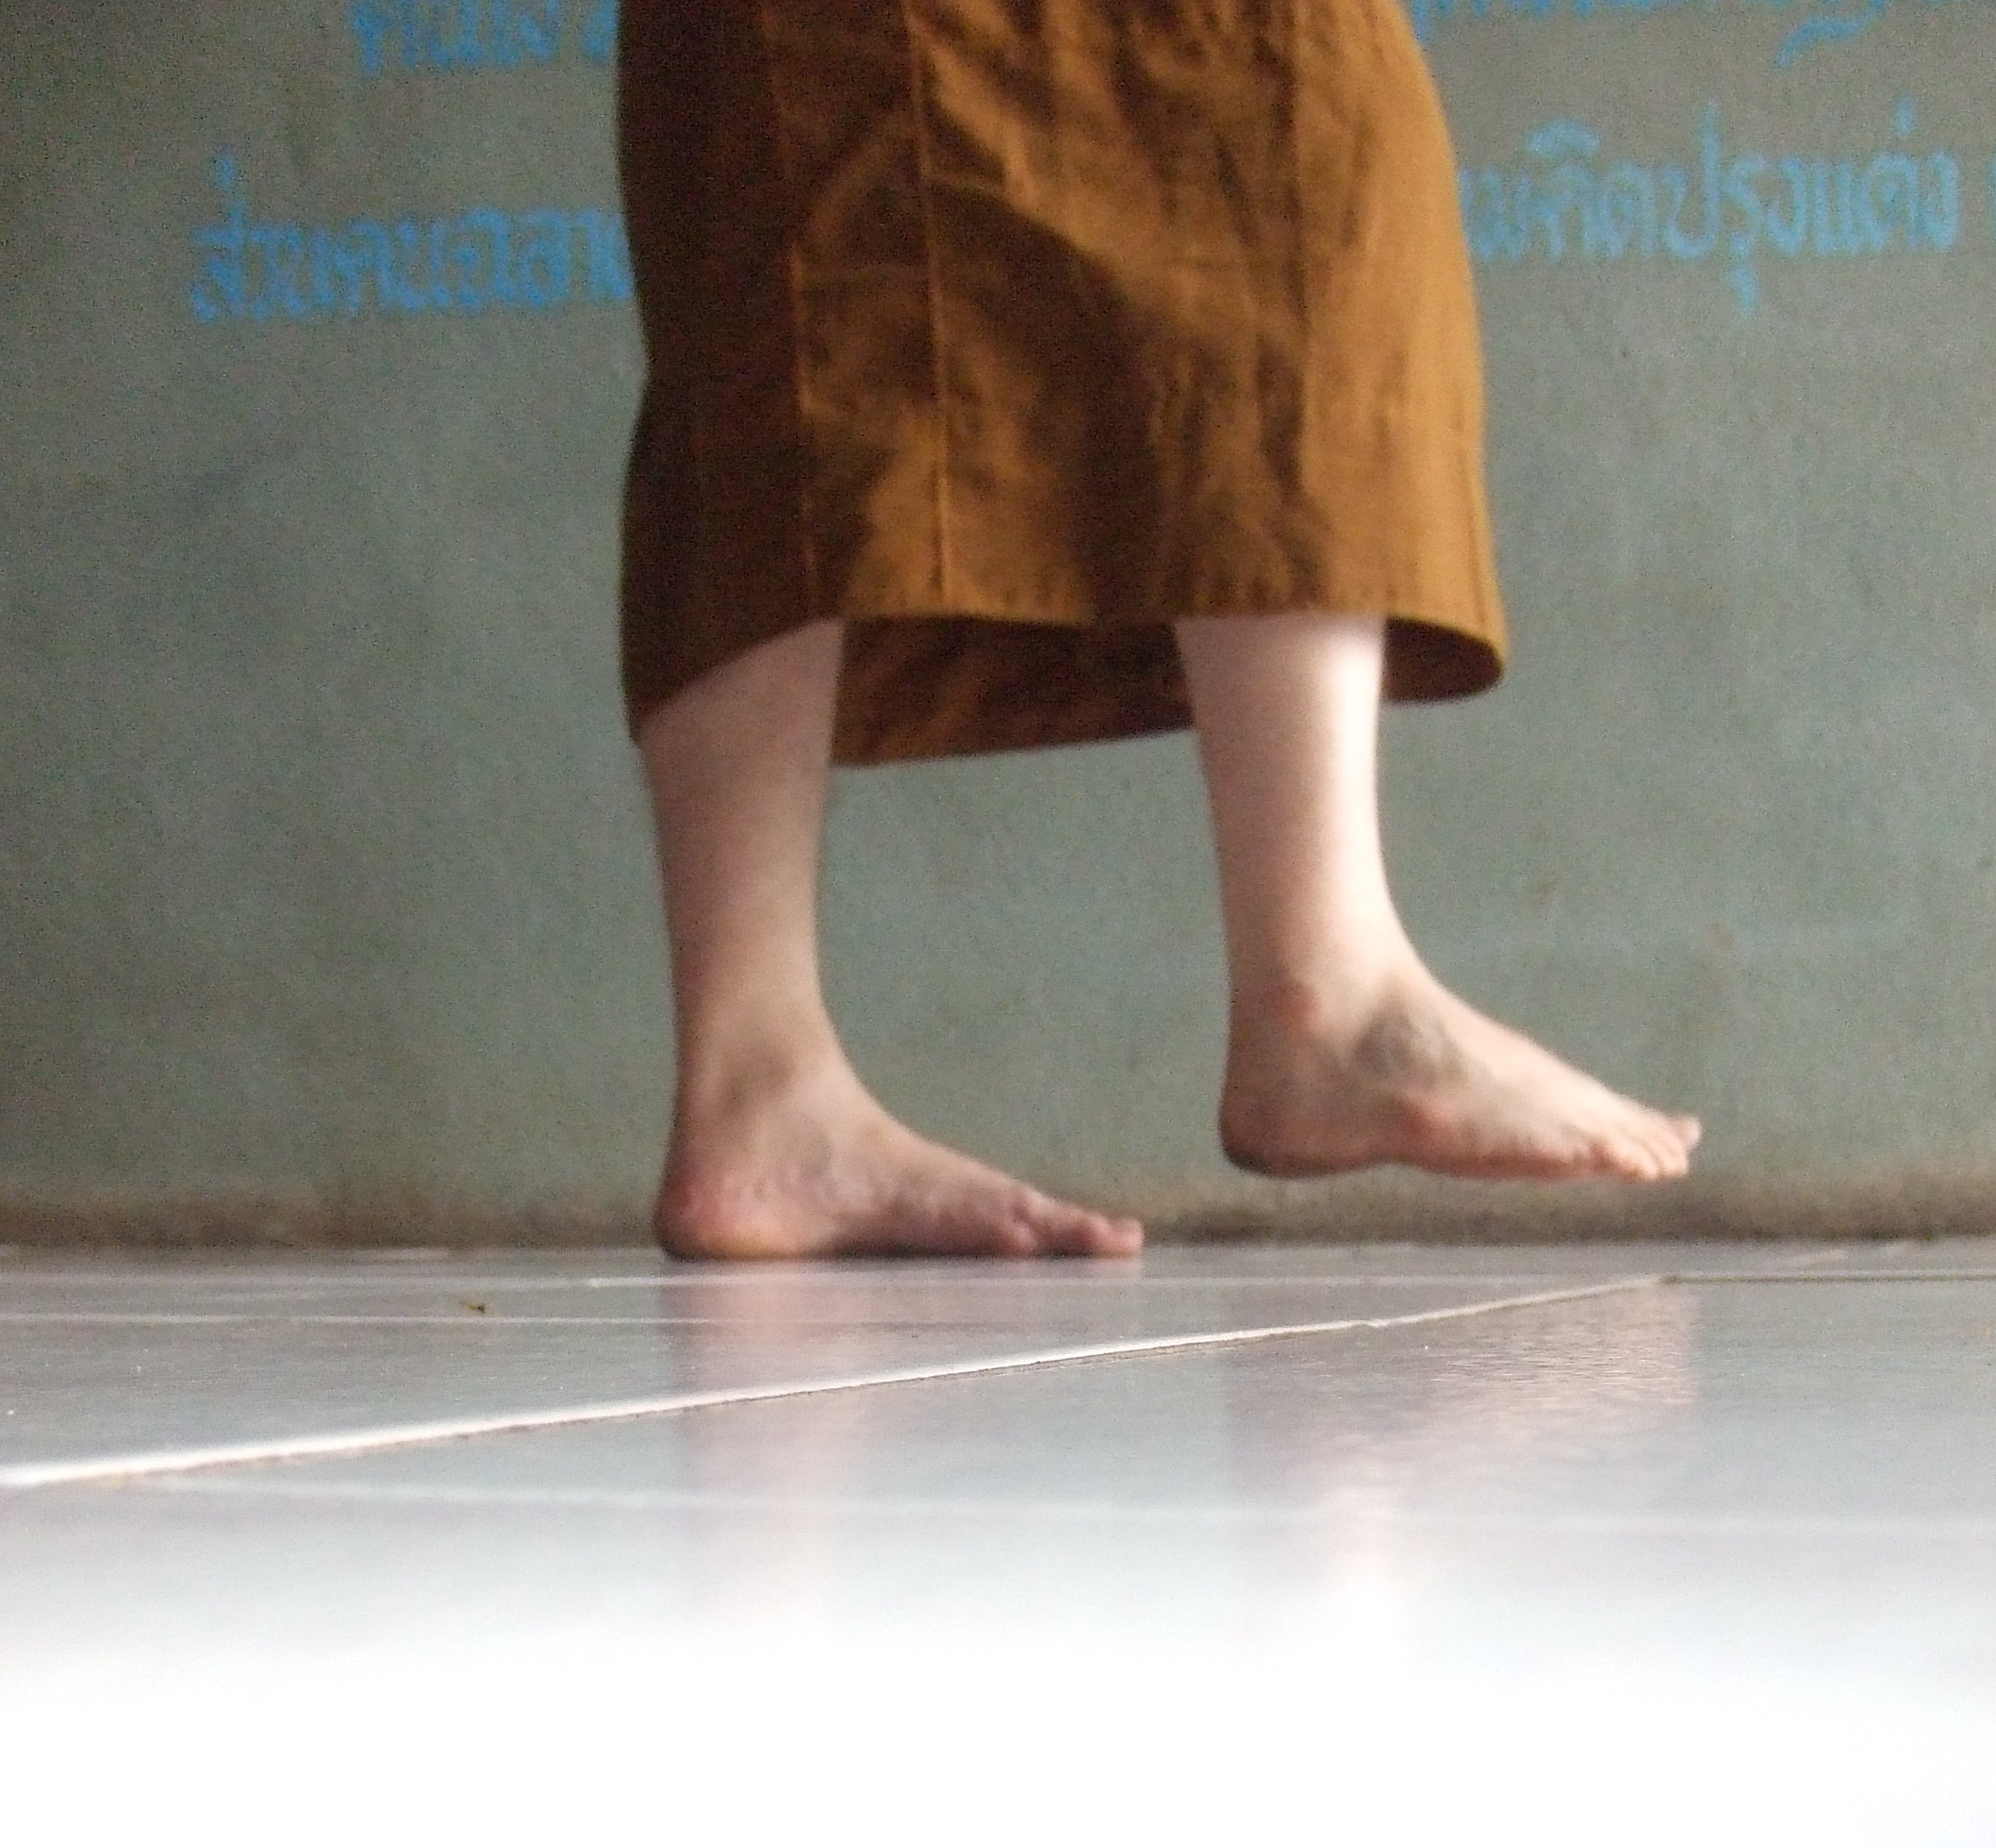
Vipassana (mindfulness) meditation
Notes:
Did a lot of walking meditation-
Can’t do with students (no language). Not into it – boring.
How can I get them “into the moment).

Slide 41
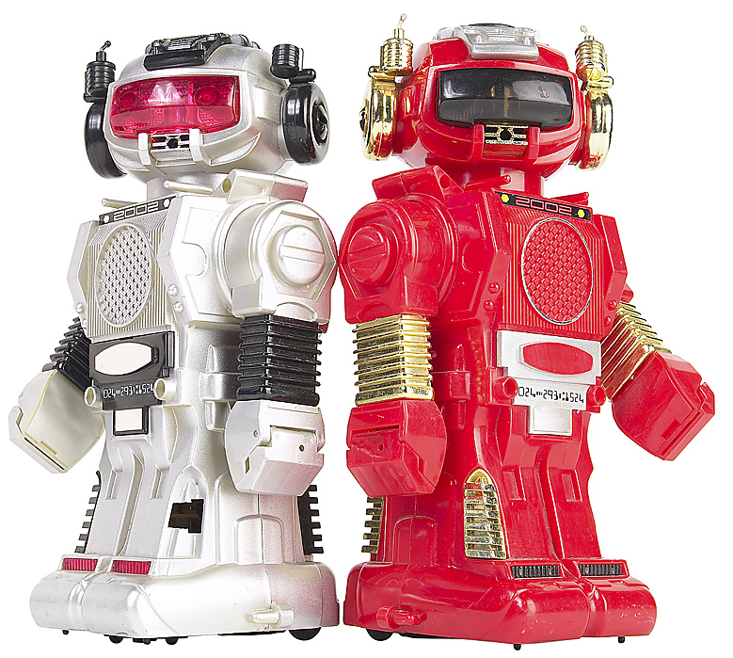
Human
robots

Slide 42
Memory check
P
E
R
M
A
ositive Emotion
ngagement
elationships
eaning
ccomplishment
Notes:
Wellbeing 2.0

Slide 43
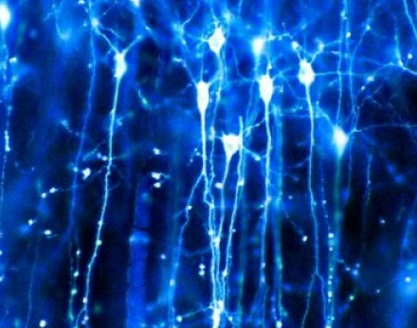
Thank you.
Achor 2010

Slide 44
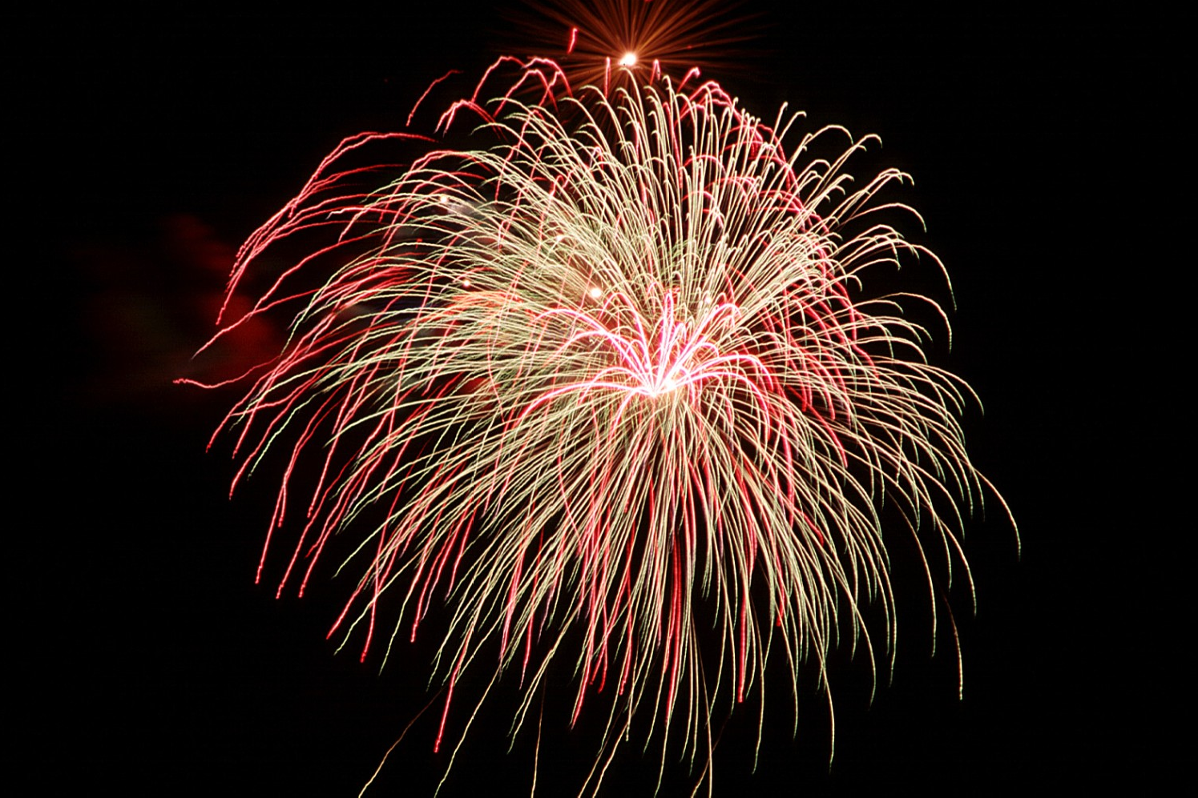
Flourish
P
E
R
M
A
ositive Emotion
ngagement
elationships
eaning
ccomplishment

Slide 45
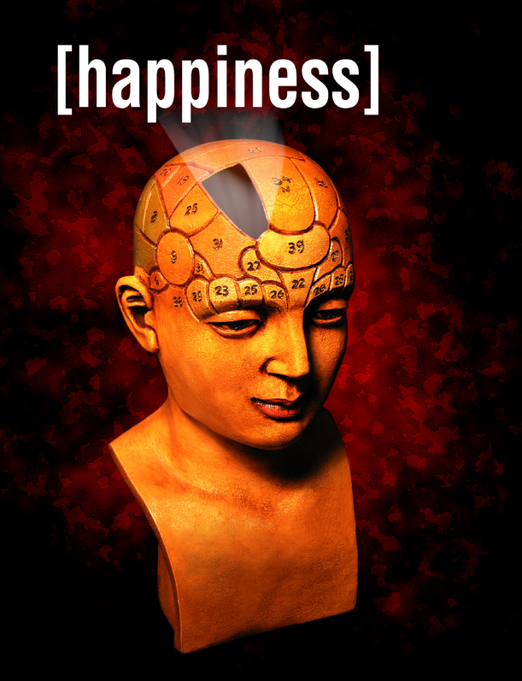
S
Wellbeing 2.0/
ELT & the science of
Q & maybe A
Notes:
Excited, delighted.
Who are you?
Positive psychology

Slide 46
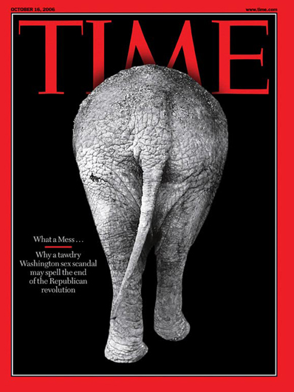
S
2 reactions:
Great!
Great, but…
Notes:
Related sessions, dozens of times, 6-7 countries/cultures:
But…. I don’t have time.
Or I have to teach the curriculum
Or But, I have to teach the required textbook
(and happiness is not Ministry of Education approved)

Slide 47
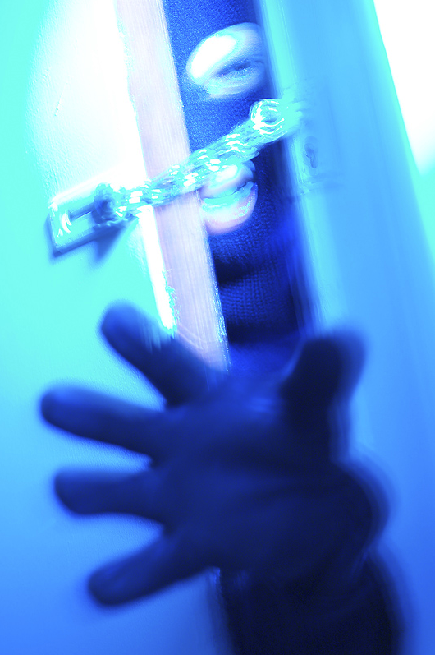
A strategy: Steal time
10 minutes for a…
warm-up
cool-down task
an energy builder
a fluency task

Slide 48
S
Thank you.
Notes:
Excited, delighted.
Who are you?
Positive psychology

Slide 49
A metaphor
borrowed*
and expanded on from
Tal ben-Shahar
savoring
* Sounds better than “stolen”

Slide 50
The best song ever
10

Slide 51
S
Rest well,
Whitney.
Notes:
With all love and respect.
We will always love you.

Slide 52
The best song ever
10
Notes:
Hit 3 times – 1st 1974. Tal young, living in Israel. Not much of a country music scene. Country and WestBank
C&W more points SUBJECTIVE

Slide 53
The best song ever
9^{1/2}
Notes:
Ode to Joy, from Beethoven’s 9th
Herbert von Karajan Berlin Philharmonic

Slide 54
The best song ever
+ 10 +
9^{1/2}
9^{1/2}
29
noise

Slide 55
1
simplify

Slide 56
Thank you.
Achor 2010

