Slide 1
Energy breaks
Human beings were not designed to sit in desks all day. Energy breaks get your students moving and energized.
Line up nonverbally is a movement activity. Students, in groups of 6-8 (or whatever is convenient) line up in a series of different ways. They see how quickly they can do it. The lining up is nonverbal, then they check by speaking.
Note: there are 9 tasks. That is probably too many for one class session. Consider doing 3-4 of them in any one class. A good way to divide students into pairs for pairwork is to do these tasks. After the last one, they work with the person next to them for their task.
Use slide 16 to explain the importance of movment. One minute of movement increases blood/oxygen to the brain by 15%
© Marc Helgesen. May be freely used for non-commercial purposes.
For more, visit: www.HelgesenHandouts.weebly.com. Click on “Physical activity…”
This slide is for the teacher’s information. The student slide show starts with slide 2.

Slide 2

Energy break

Slide 3

Line up nonverbally #1
Notes:
Height Nonverbal communication is Communication
- birthday (Jan – December) - need to speak to check
- time you got up today. (drop if no time)
- How long it took you to get here today
-

Slide 4

Make groups of 6-8.
How fast can you
line up each way?
No speaking.
Gestures are OK.

Slide 5
No speaking.
Gestures are OK.
No speaking.
Gestures are OK.

Slide 6
When you finish…
sit down.
Check by speaking.

Slide 7

Line up by…
height.
Shortest to tallest.
Check by
speaking.

Slide 8
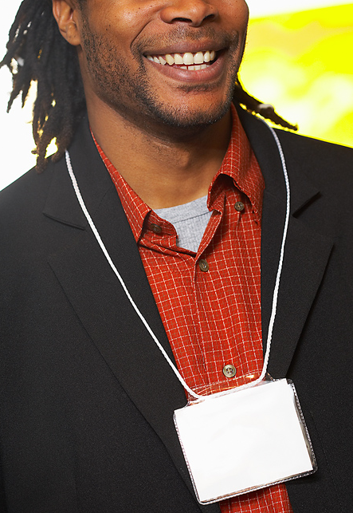
Line up by…
How many
letters in
your name.
(1st and last)
Least to most.
Check by
speaking.
Hello.
I’m…

Slide 9
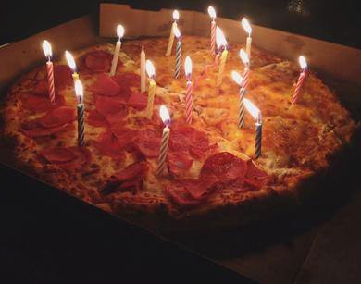
Line up by…
birthdays.
January
to December
Check by
speaking.

Slide 10
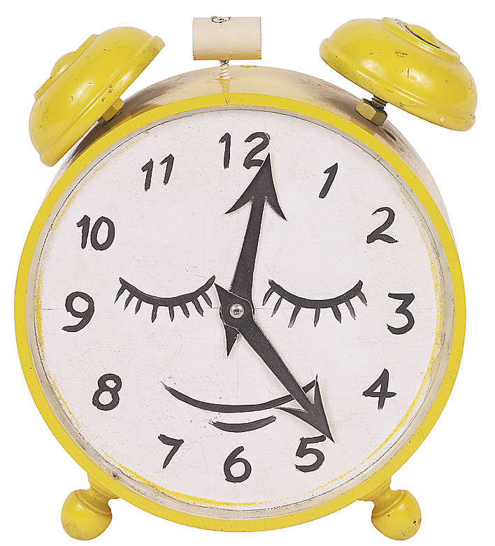
Line up by…
the time
you got
up today.
Earliest to latest.
Check by
speaking.

Slide 11

Line up by…
how long
it took to get to
school today.
Shortest time to
longest.
Check by
speaking.

Slide 12

Line up by…
the time
you went
to bed
last night.
Earliest to latest.
Check by
speaking.

Slide 13
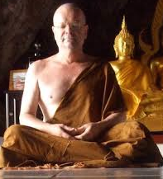

Line up by…
hair length.
Shortest to longest.
Does
everyone
agree?

Slide 14
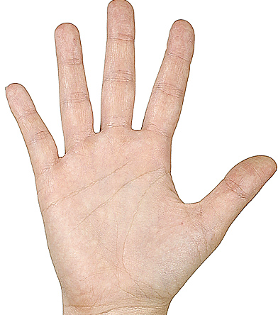
Line up by…
the size of
your hand.
Smallest to biggest
Compare.

Slide 15

Line up by…
time
on-line
each day
Least to most.
Check by
speaking.

Slide 16
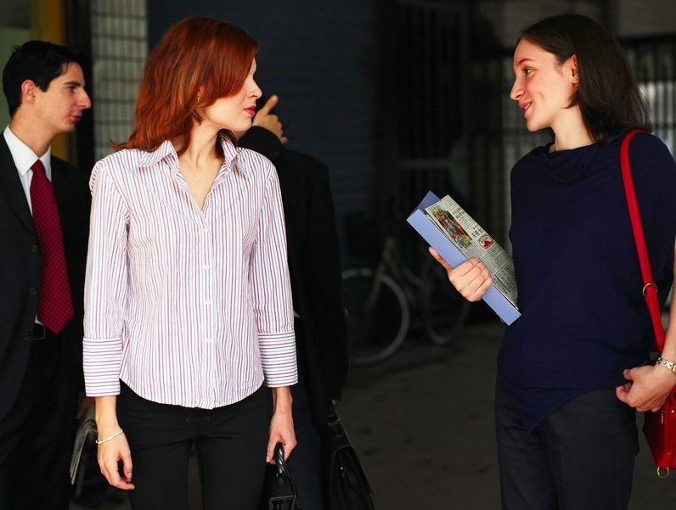
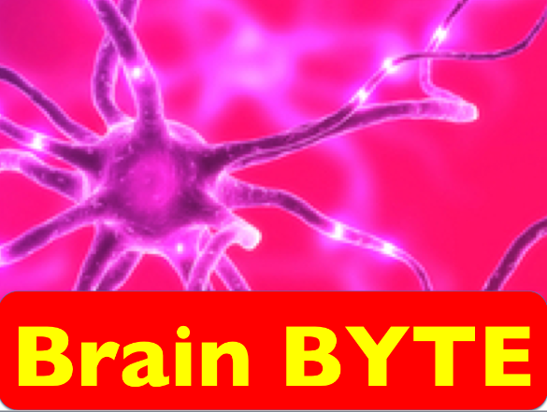
When you stand and move, it increases blood and oxygen
to your brain.
Source: Sousa, D. (2011) How the Brain Learns, Thousand Oaks, CA: Corwin Press.

Slide 17
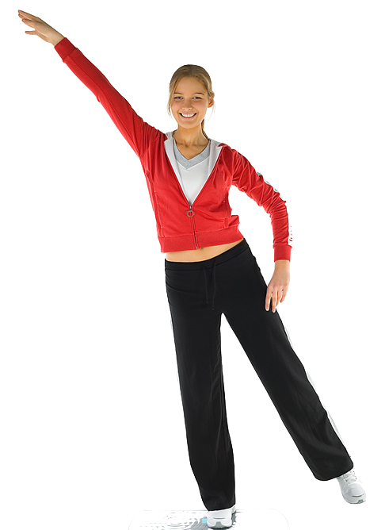
Let’s move!

Slide 18
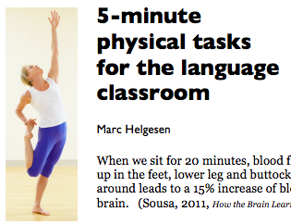
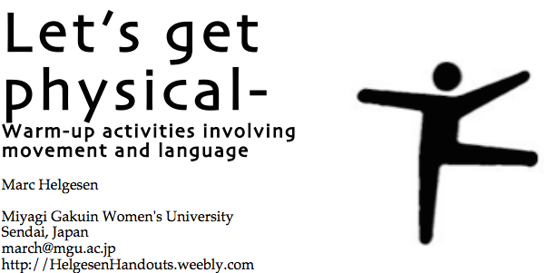
More ideas at
http://tinyurl.com/ELT-physical

