Slide 1
Happiness
Dictation
Photo: Fernando Vega. CC Creative Commons. Flickr.com

Slide 2
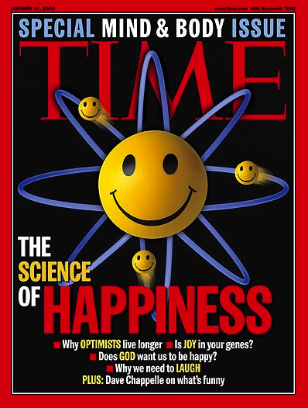
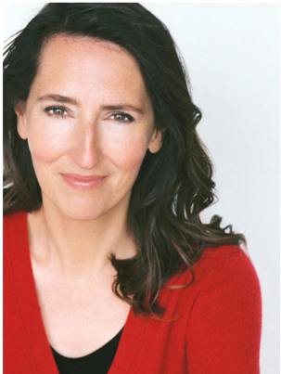
Sonja
Lyubomirsky
Notes:
UC- Riverside

Slide 3
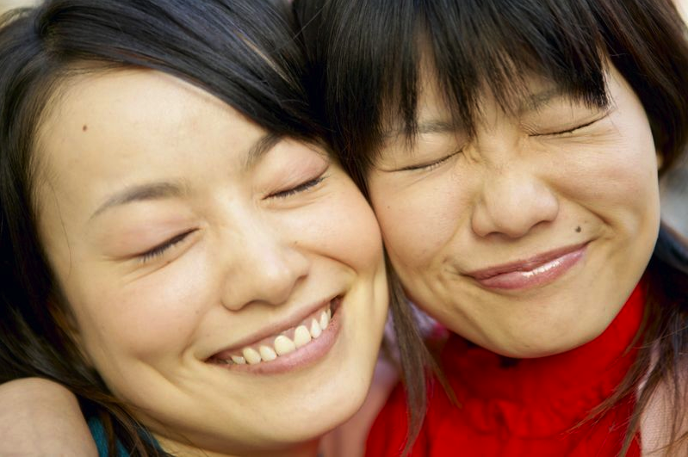
Positive psychology
is about finding out what happy, mentally healthy people do.

Slide 4
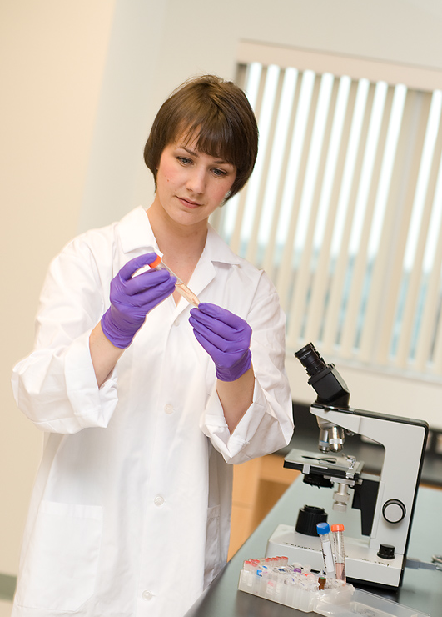
How to we get the information to our students?
Scientists know.
l
☺

Slide 5
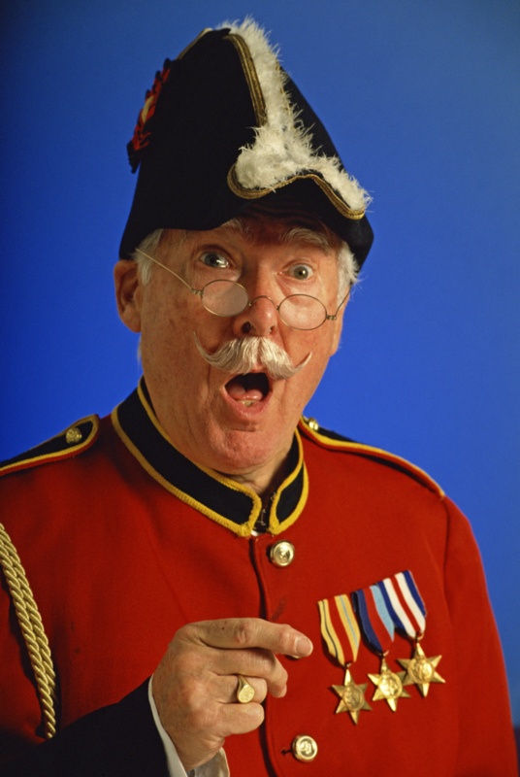
Dictation
If you use
dictation,
does that make
you a dictator?

Slide 6
good things
You say:
What number?
You say:
What’s your sentence?
You write it.

Slide 7
kind
thank you
friends & family
forgive
hurt you
health & body
when they happen
problems and stress

Slide 8

Remember
good things
Notes:
Count your blessings

Slide 9

Say,
“thank you.”

Slide 10
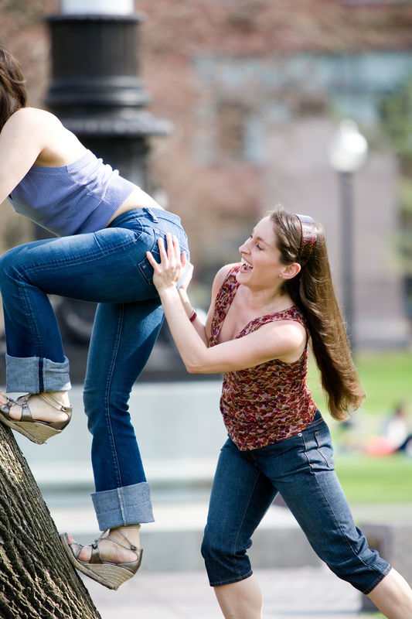
Do kind
things

Slide 11

Friends
& family
Notes:
Take time for family and friends.

Slide 12
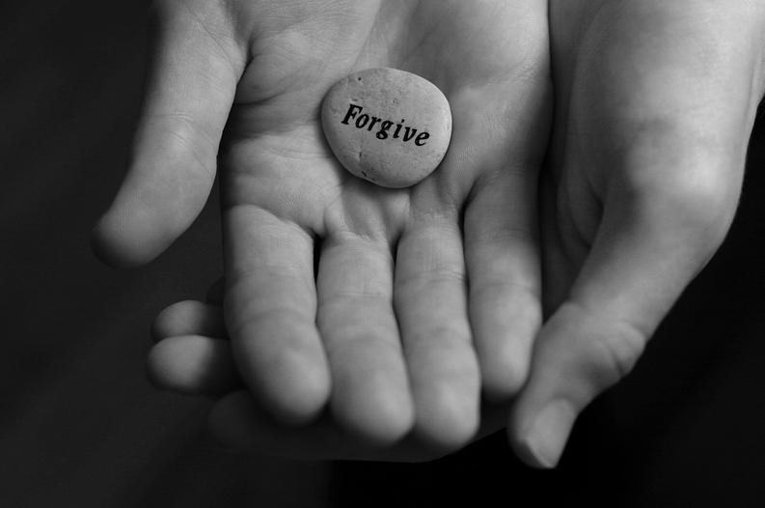
Forgive
Forgive
Notes:
Forgive others. Forgive yourself.

Slide 14
Teen brain not fully developed
Forgive
yourself
Notes:
Limbic system (emotions) fully functioning by age 15.
Prefrontal cortex (executive function) not until 25 or so.
http://mobile.edweek.org/c.jsp?cid=25920011&item=http%3A%2F%2Fapi.edweek.org%2Fv1%2Fblog%2F65%2Findex.html%3Fuuid%3D75799
Education Week Praising Effort may not promote growth mindset Sparks

Slide 15
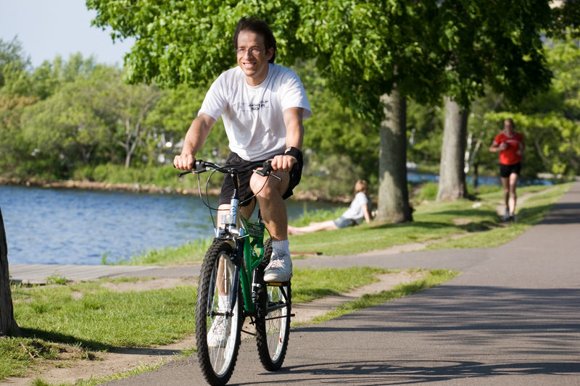
Stay
healthy
Notes:
Stay healthy. Take care of your health and body.

Slide 16

Notice good things
Notes:
This is different than remember. This is real time. English teacher: Remembering is past tense. This is present, present simple, present continuous. RIGHT Now

Slide 17

Deal
with problems
Notes:
Happy people, when they run into negative experiences, know they will pass.

Slide 18
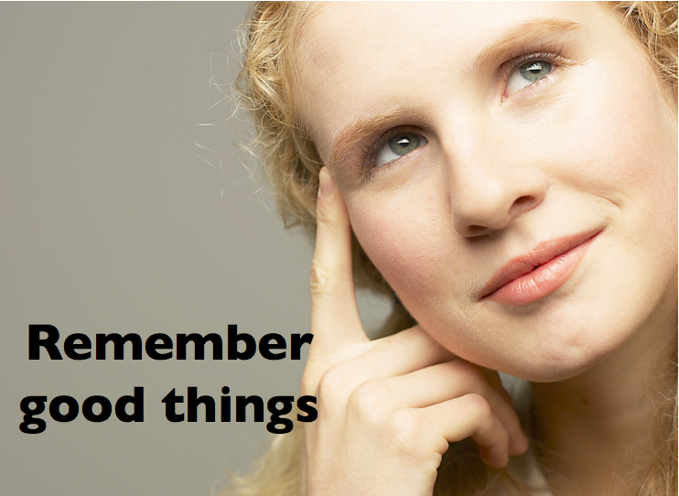
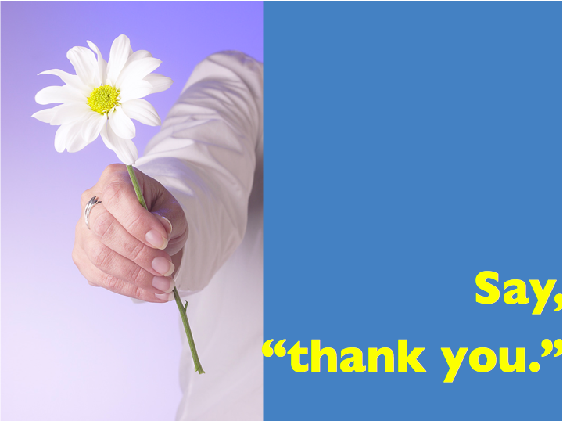
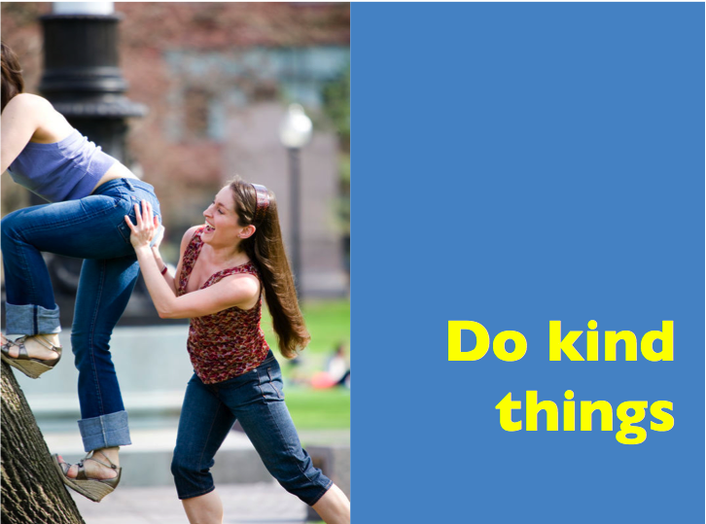
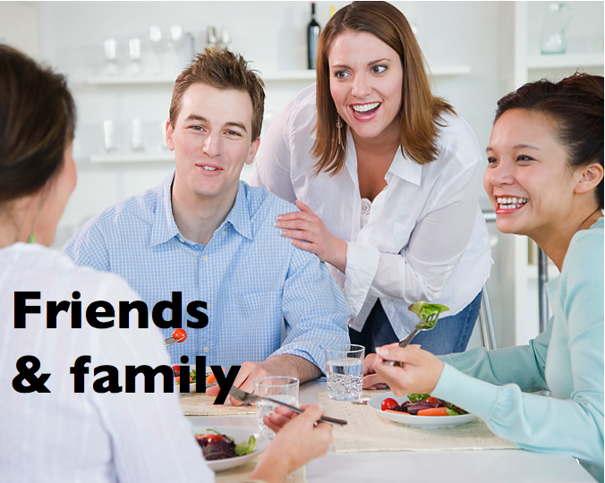
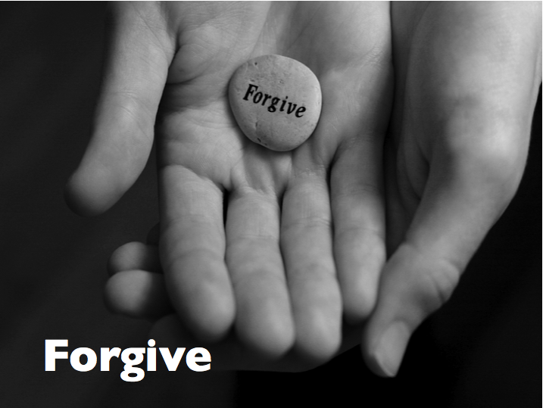
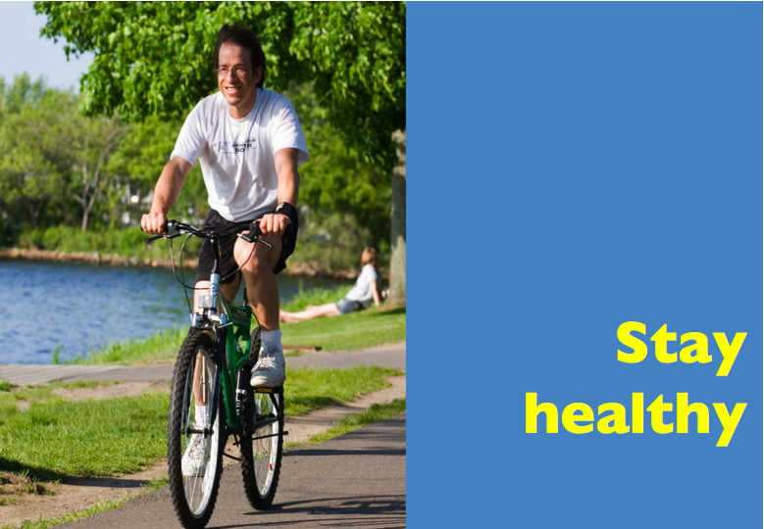
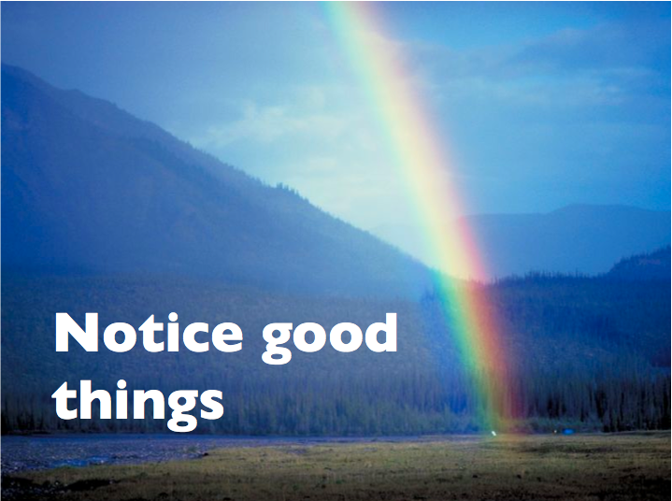
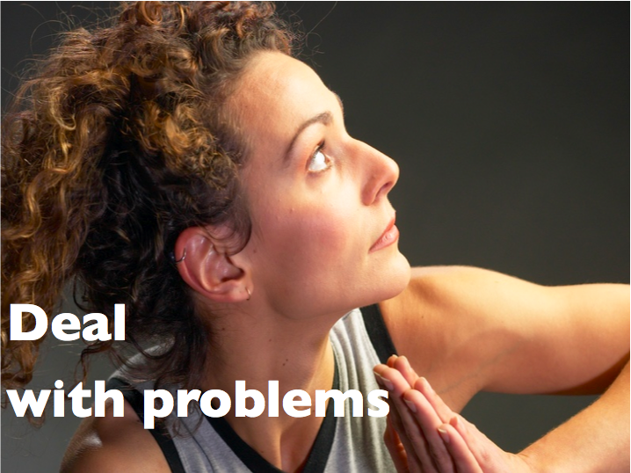
Topics
To be
happy
Grammar
Functions
Sonja Lyubomirsky, UC Riverside

Slide 19
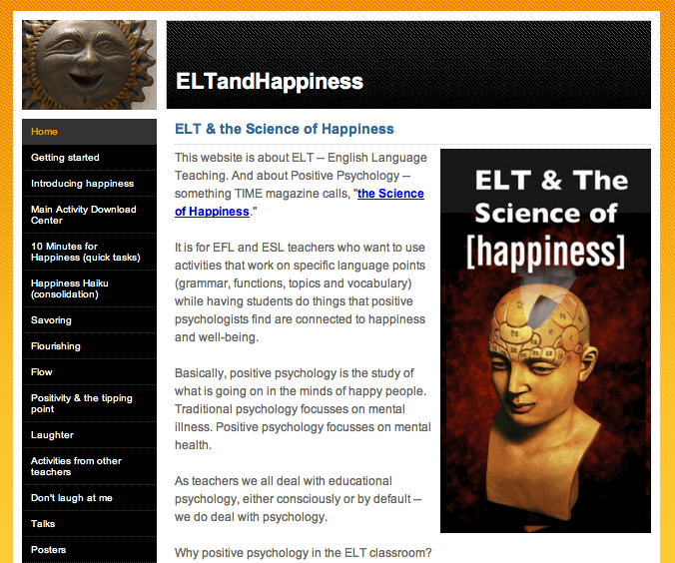
.com
Notes:
Next, how to introduce those
8 ideas into the elt classroom
You don’t have to remember. Download

Slide 20
.com
Notes:
Next, how to introduce those
8 ideas into the elt classroom
You don’t have to remember. Download

